Slide 1


Department of software engineering
DATABASE MANAGEMENT SYSTEM
Admission portal
Group Leader: omesh kumar BSE-23F-116
Group MEmbers: M. asif
Zubair ali
Submitted to: Miss aqsa umer

Slide 2



Admission Portal Database:
An admission portal database streamlines the student application process by enabling online submission, real-time tracking, and secure document management. It enhances communication through automated notifications and direct messaging. The database supports efficient evaluation with online reviews and decision recording and provides valuable insights through data analytics and reporting.

Slide 3
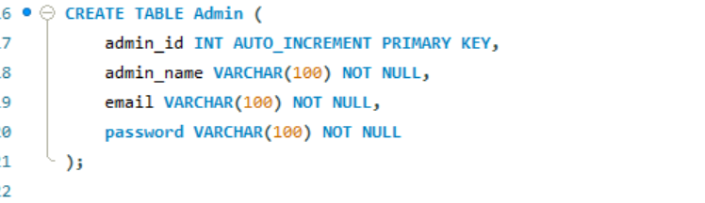
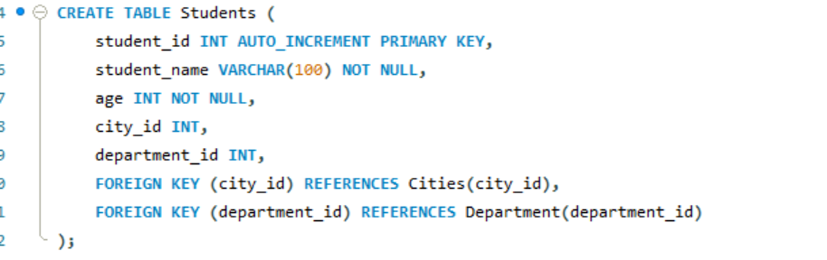
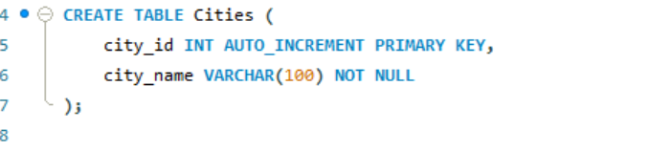
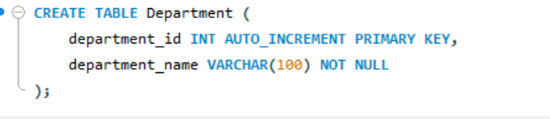
Now lets make a database of admission portal

Slide 4
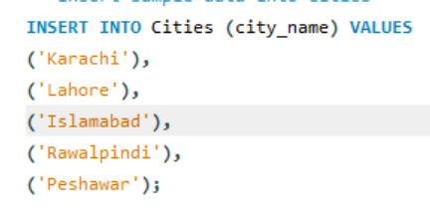
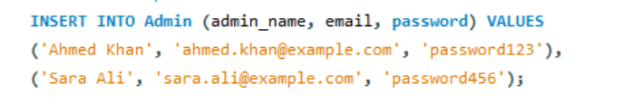
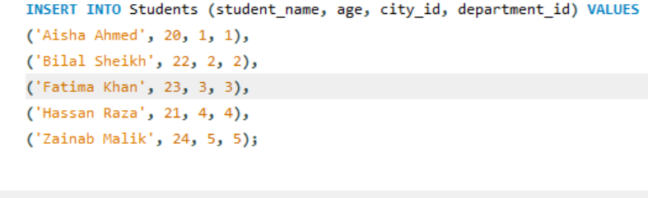
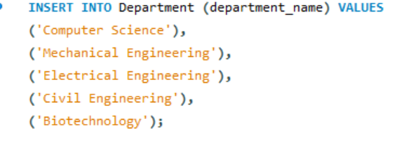
Now we have to insert values

Slide 5
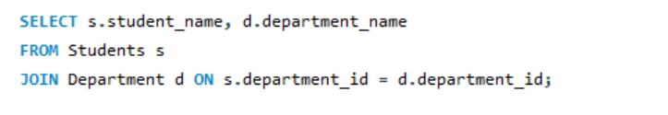
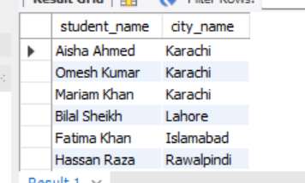
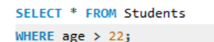
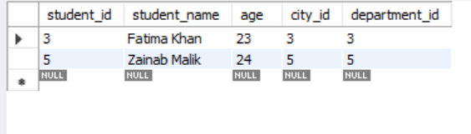
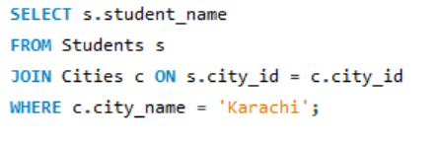
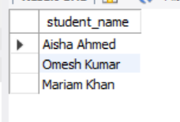
Some of quries from 50 which we have made
output
q.1
q.2
output
q.3
output

Slide 6

Contribution
Omesh Kumar: 20 lines of query Created whole database & powerpoint presentation
Zubair:
15 Lines of query
M.Asif:
15 lines of code

Slide 7

Thank You!

